Slide 1


EMPOWERING YOU TO CREATE SPACES THAT EVOLVE WITH YOU
Raising USD $1.1M in pre-seed
Notes:
Started as a furniture + design company in 2015. Our ethos are rooted in enduring design, quality, and good value – not buying more , but buying well
Lest of all, we are antithesis to the idea of disposable furniture

Slide 2



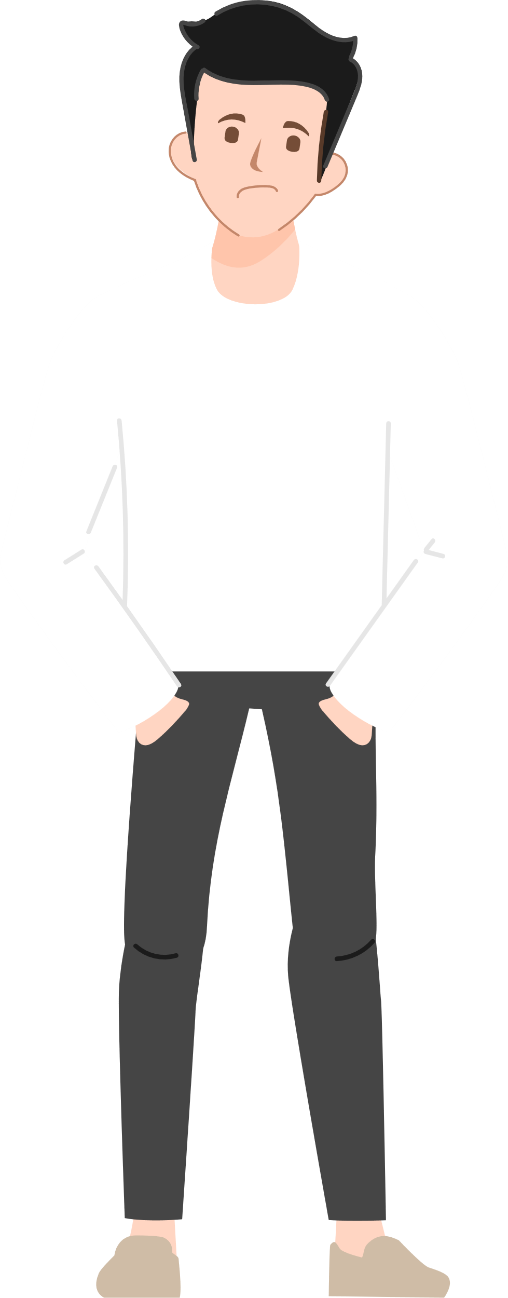





THE PROBLEM
Our lives evolve and needs change …
Year
1
Year 7
Year 15
Year 24
Year 38
SINGLE
COUPLE
YOUNG FAMILY
GROWN-UP KIDS
EMPTY NESTERS
Notes:
Our homes are not designed to adapt to different stages of our lives and changing needs.
it does not Accommodate changing number of household members, Allow for new spaces nor functions easily
Support accessibility for aging and special needs when required

Slide 3


THE PROBLEM
But typical homes are not built to adapt to us
Templated
Static
Outdated
Over the years:
Cannot accommodate the number of household members
Hard to create new spaces and functions
Not accessible for aging and special needs
Cannot keep up with changing trends
Notes:
Our homes are not designed to adapt to different stages of our lives and changing needs.
it does not Accommodate changing number of household members, Allow for new spaces nor functions easily
Support accessibility for aging and special needs when required

Slide 4
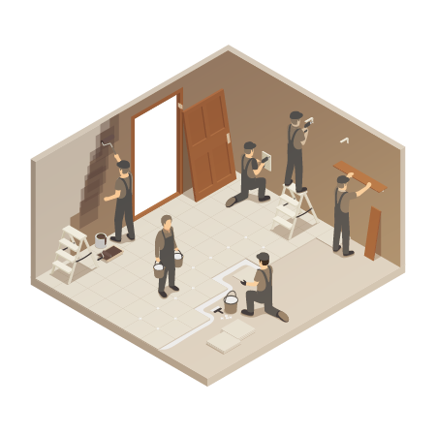
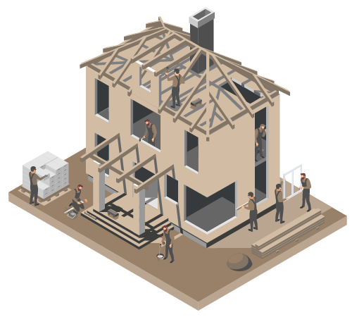
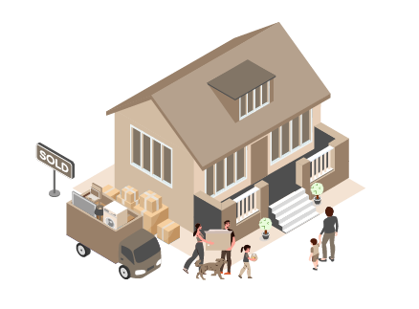


THE PROBLEM
Options are not affordable and sustainable
Option 1. Renovate
Option 2. Build
Option 3. Sell, Buy & Move
$30k-$180k+
$180k-$500k+
Stamp Duty / Agent’s Fee / Moving Cost
6-12 MONTHS
12-24 MONTHS
4-12+ MONTHS
*4 Bedroom House (1600sqf)
Notes:
A massive shortage of skilled contractors, increased cost and shortages of materials and delays in the supply chain have made home renovations a costly and time-consuming endeavor.
Higher cost of house and land, rising mortgage rates, supply chain and labor shortages, higher stamp duties and agent’s fee are making this option more discouragingly unaffordable.
mindboggling how consumer goods are cheaper but construction keeps getting more exp

Slide 5

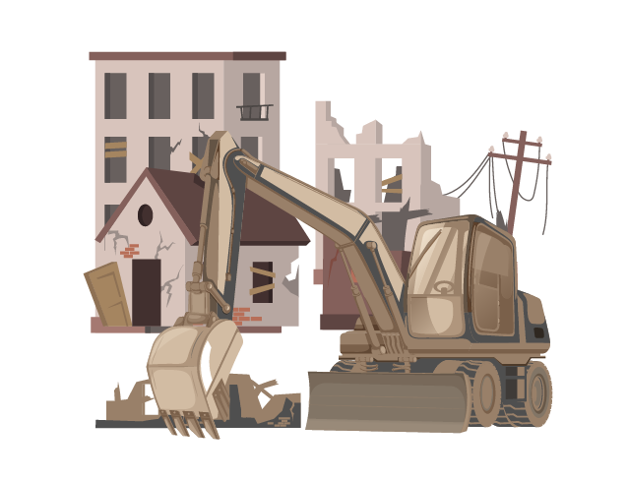



THE EXISTENTIAL PROBLEM
Leading to the problem of waste in the age of climate crisis…
1B sq.f* of buildings is being demolished and rebuilt yearly
1/3 of global waste stems from construction & demolition
Construction being the biggest contributor to global warming
% of global carbon in 2019 emissions
Aviation
Construction
*92M sq.m
Washington D.C
Notes:
1B sqf of buildings demolished and rebuilt. Avg life span is 40 years
Half the size of WASHINGTON DC
13% of Singapore . In 7 years, you could rebuild surface area of the entire island
Building construction emit 35% CO2 – biggest contribute

Slide 6
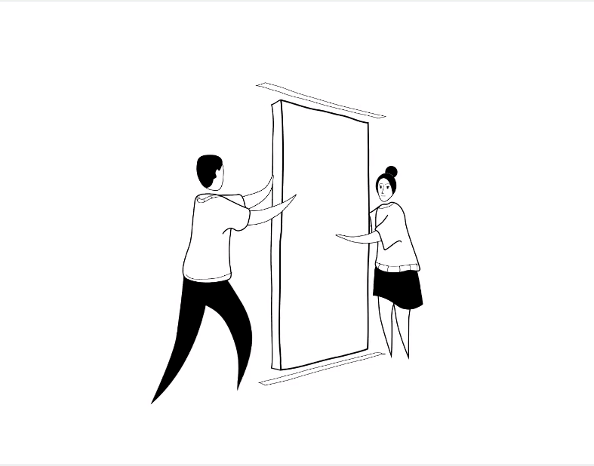


THE SOLUTION
Imagine the future when our homes can evolve with us
When it can easily transform into a place that fits our needs, as they change over time
We bring you this future
Notes:
Re-create your home to fit you each time your lifestyle changes.
Do it sustainably with zero waste and environmentally friendly materials.
Completed within a day with minimal costs.

Slide 7
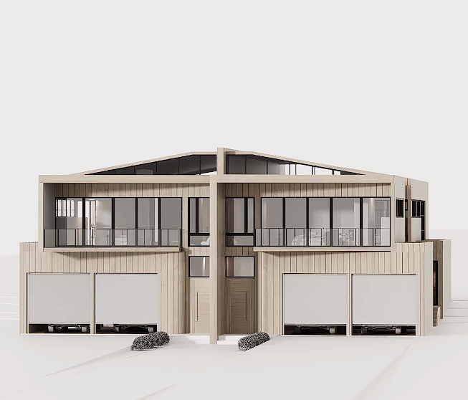


OUR SOLUTION
The home of the future is dynamic
& sustainable
One that gives us the power to create and re-create it exactly how we want it
View Case Study House
Notes:
real case study house that we’ve deisnged.
It’s an infill housing , mid density zoning that is on the city fringes.
site is subdivide into 2 separate townhouse, each about 300sqm of land.
What this shows is that if we can do it for a high density house, we can apply it easily to any home.

Slide 8
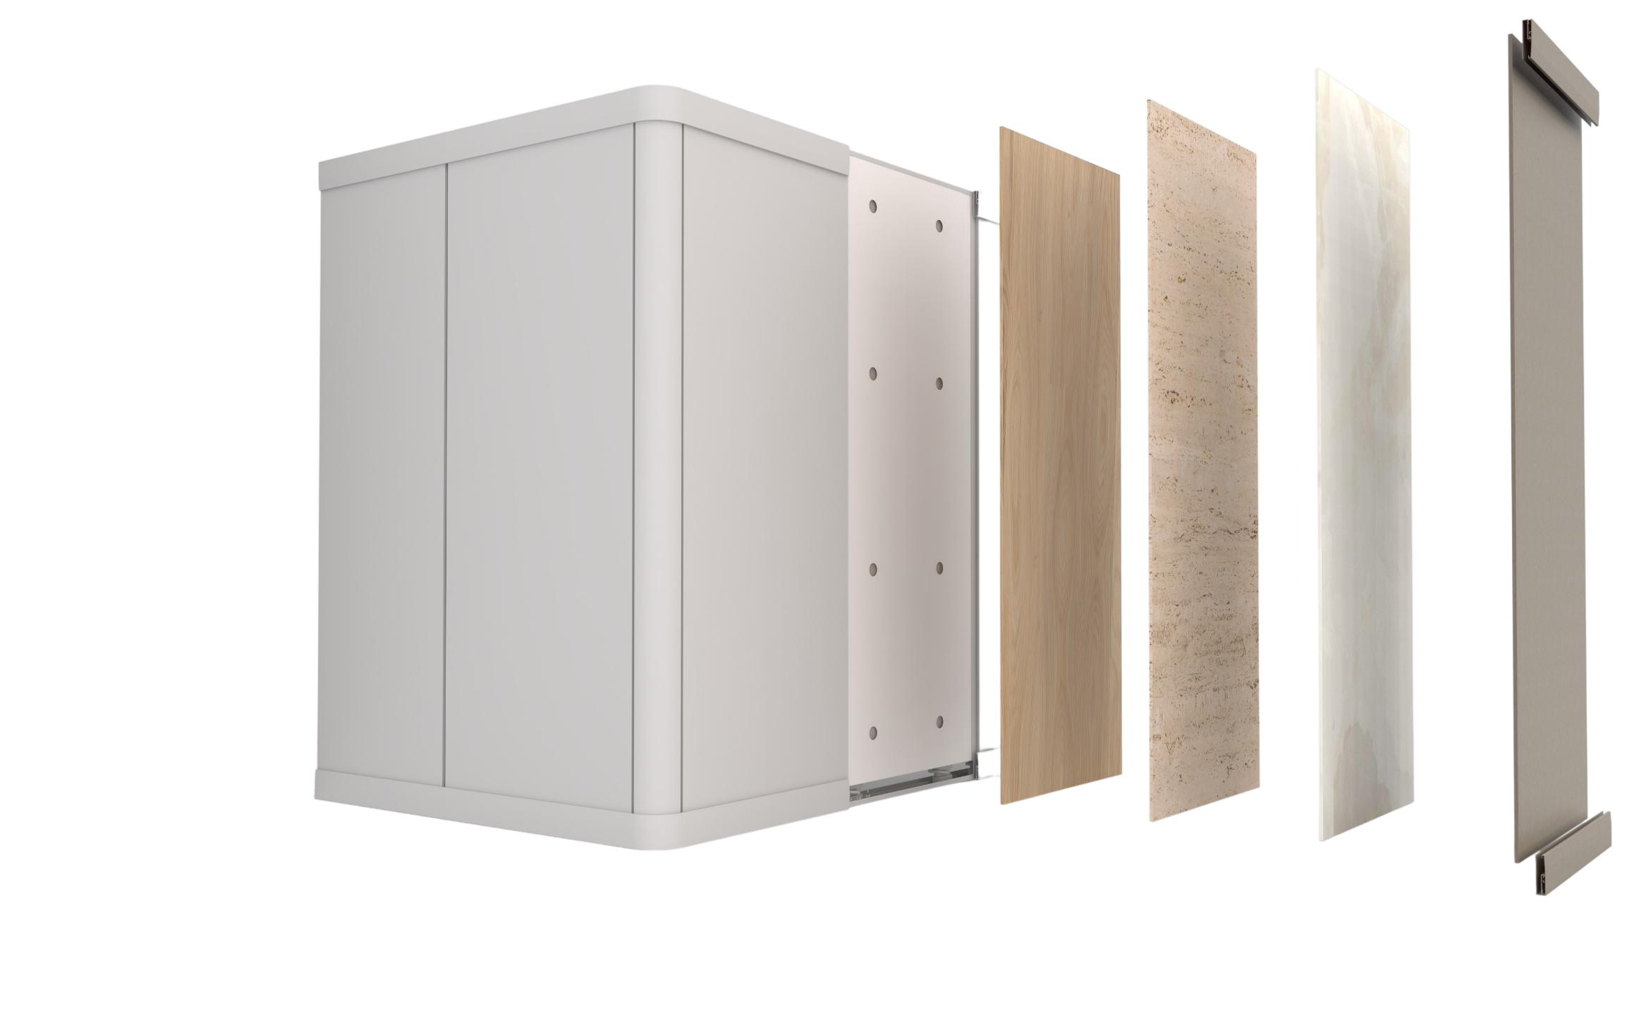







OUR PRODUCT
Innovative, patent pending system that surpasses the standards of a typical partition wall
Water-resistant
Superior acoustic insulation
Mold-resistant
Natural & non-toxic
With no VOC
Termite-proof
1.5x fire rating compared to gyprock
SEE THE PROOF OF CONCEPT
Notes:
features - better

Slide 9
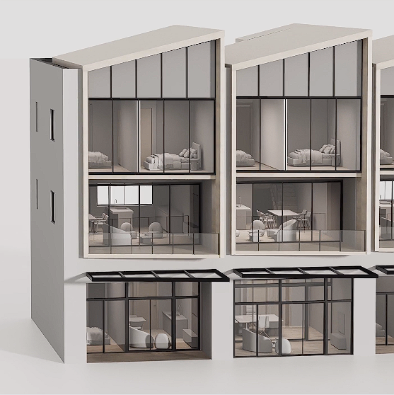
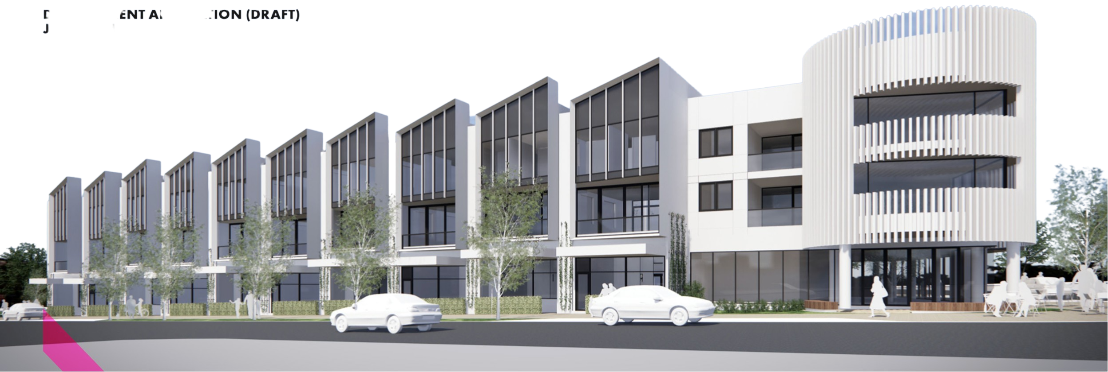
OUR SOLUTION
Ö.Wall will fundamentally change apartment design, building & living
Paving a way for a new generation of apartments that are more than just temporary shelters
View Case Study Apartment
Notes:
A greater potential lies in apartment living. The answer to sustainability is Higher desnity living and to stop urban sprawl.
If apartment can adapt to buyers instead of developer’s yields, ppl will be more open to living in apartments.
Increase the value of the house , and having to give subsequent buyers the flexibility to adapt the space tot their needs. Wbat this means? You open up the pool of buyers. (wouldn’t it be great if devlopers are not compelled to build 200 1bed , 300 2xbeeders but to cater to market demands.

Slide 10
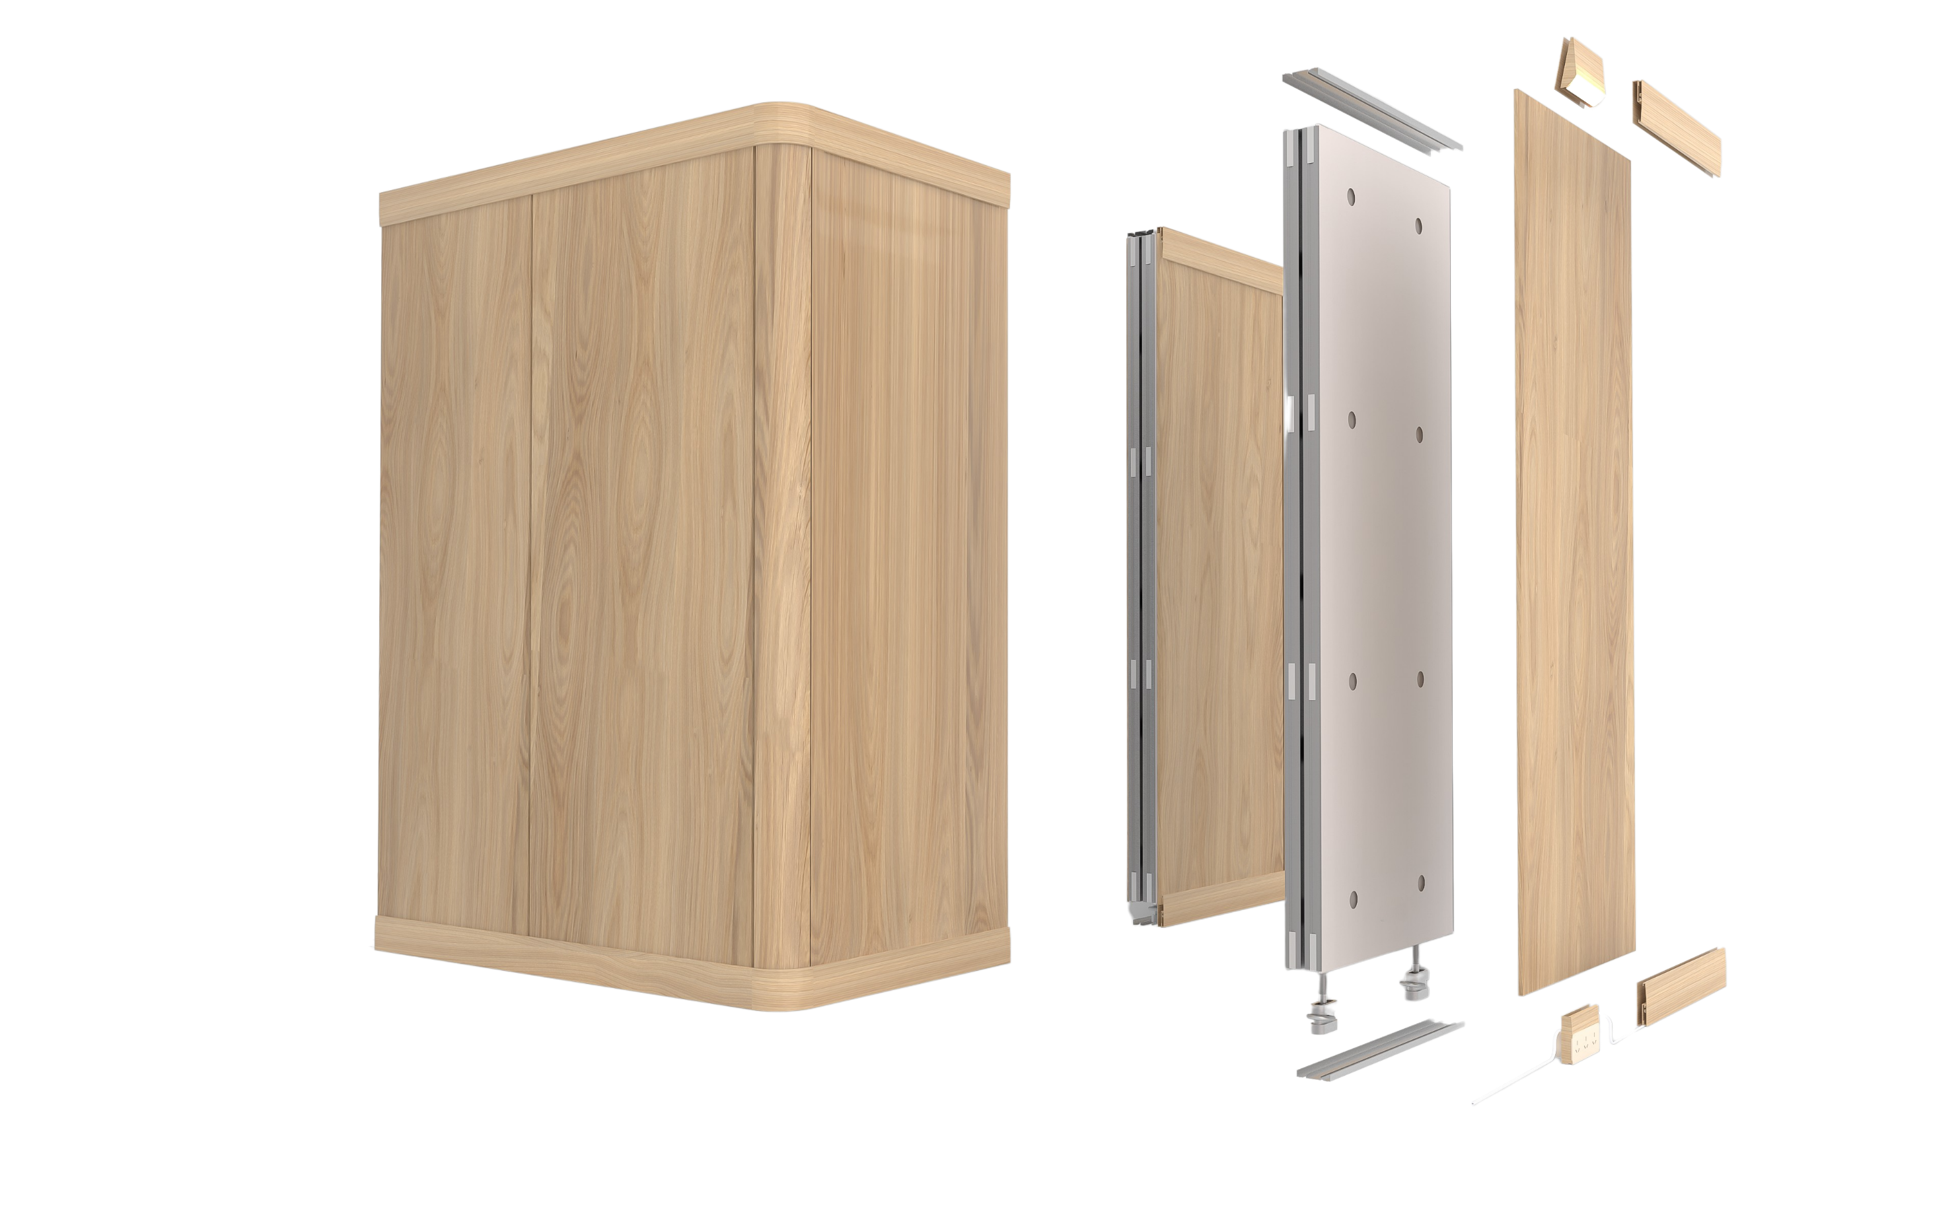
OUR PRODUCT
Revolutionary housing system made of kit-of-parts
Modular, dynamic wall pieces
Fit for any house
Anyone can easily assemble it
Changeable skirtings & cornices
Numerous styling options with Ö.Skins
Plug & play lights & sockets
INNOVATIVE, PATENT PENDING SYSTEM THAT TURNS WALLS INTO PIECES OF FURNITURE
Notes:
Key features of it all – modular, pre –fab , no wastage, anyone can do it, fits any house, changeable, plug and play
No carpenters, no plasterers, no painters, no electricans, no patch up and damages.

Slide 11


VISION
What Canva did for graphic design, Öopenspace will do for interior design & building+renovation.
Easy to use for non-designers and professional digital designers
Alternative for a set of professional editing tools
Saves time
Cuts costs
Easy to use for homeowners, occupants, design professionals and builders
Alternative to (or removes the need for) hiring a team of professionals from designers to builders
Saves time
Cuts costs
Cuts waste & emissions from our environment, conserving our natural resources
Notes:
Our mission is to empower everybody to change the layout of their homes as lifestyle changes - easily, affordably & sustainabily

Slide 12



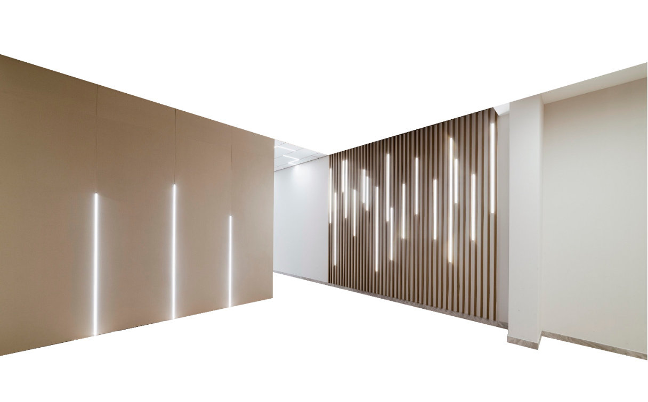
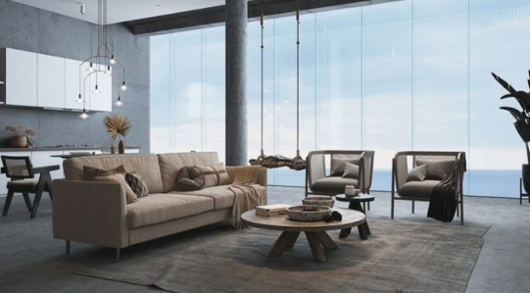
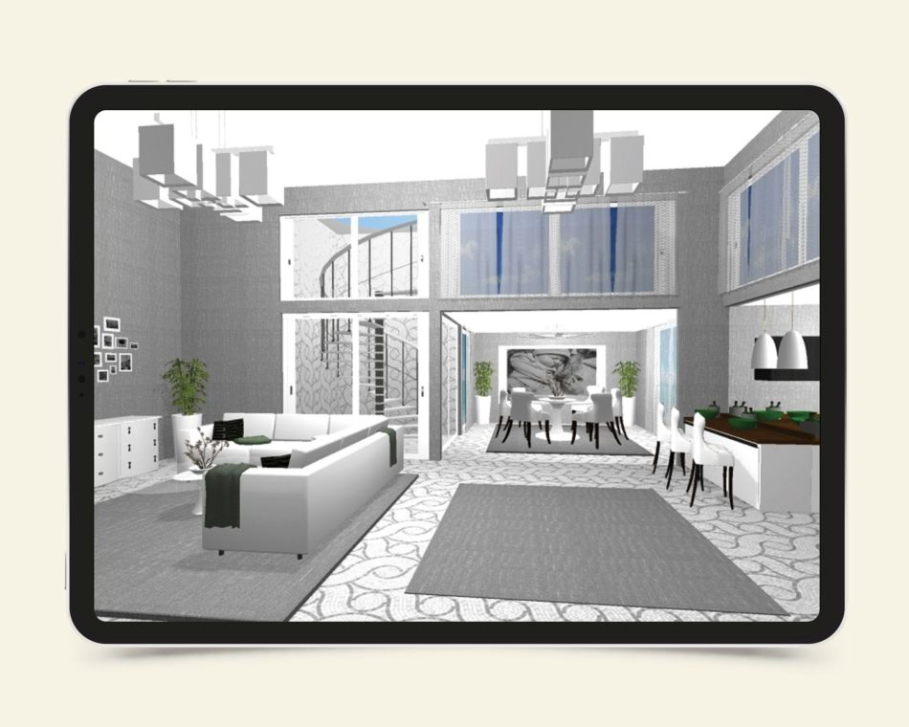
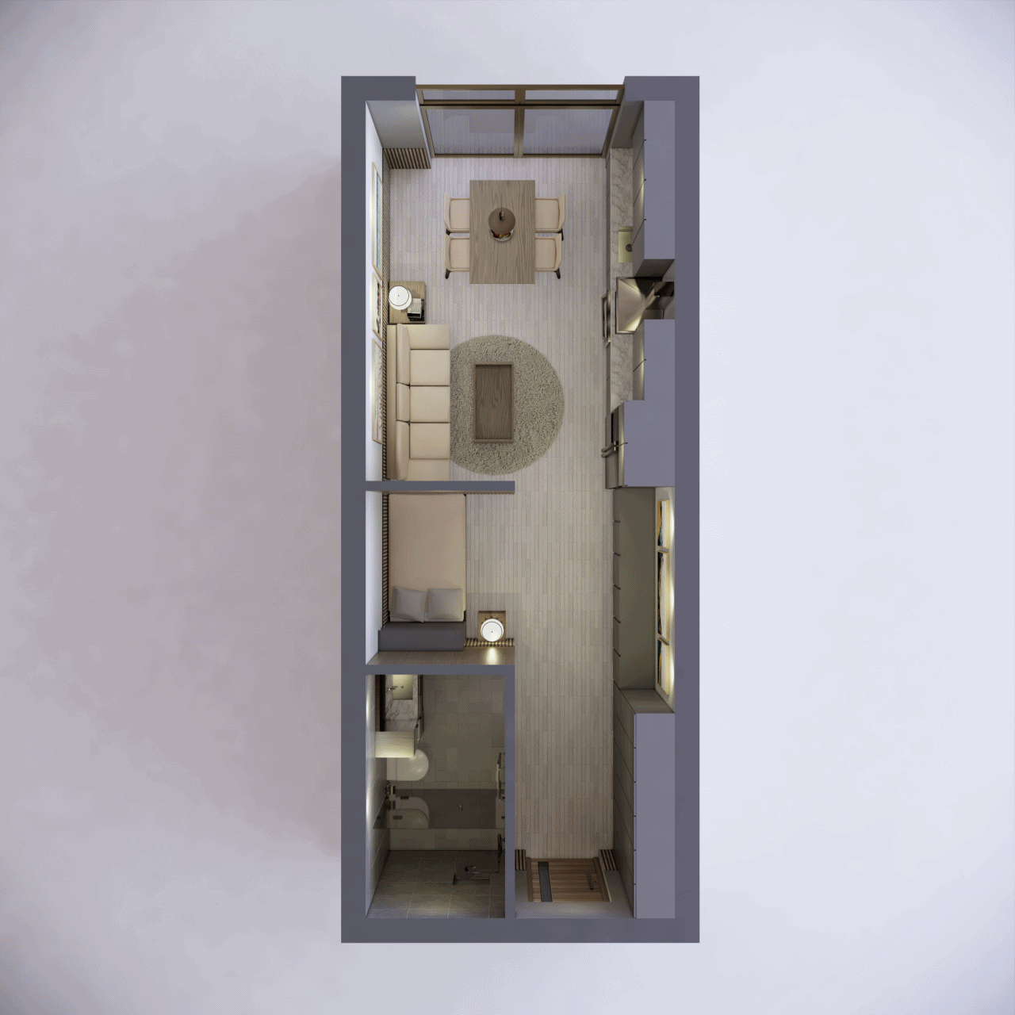


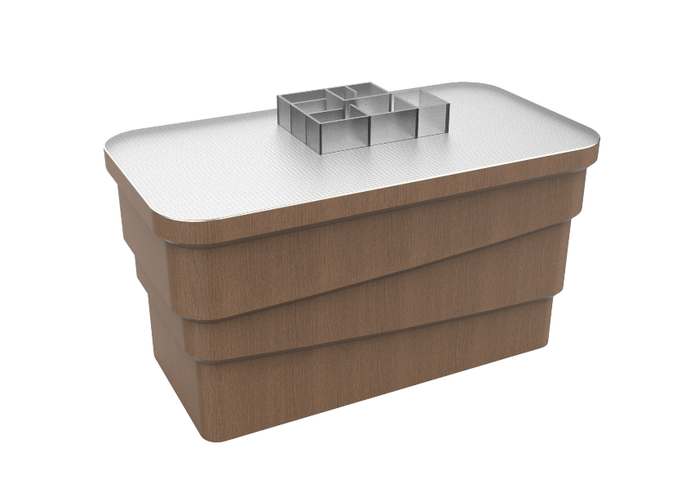







OUR 3 KEY DISRUPTIVE PROPOSITIONS
1. Empowering you to design your own interior space
Before
Now
$30k-$90k+
Aided-design with AI.
Visualize in real-time
2-6 MONTHS
Architects & ID
Tender
$0
Re-negotiate
Shortlist builder
Upload your floor plan and the parametric app will show you different layout options.
Visualize your layout with AR/VR with an immersive tactile experience in the showroom.
Re-design
Approval
Start to Build
Get immediate pricing
Just add to cart and you will know how much it all costs
Have it delivered to your doorstep
Simply click buy and your new interior will be on its way, ready to be assembled.
Notes:
The current process – ID / architect – design, tender, builder, re-deisgn, etc…
A by product of what we’ve done is having create a new standard of building that will allow a seamless design experience.
We can make the creative experience accessible to all. What canva did for graphic design, we will do for interior and home design.
Imagine – on website, doing a layout, parametric [program that aids the design process and showing the multiple spatial possibilies , to visualize it, and critically, to know how much it cost.

Slide 13










OUR 3 KEY DISRUPTIVE PROPOSITIONS
2. Renovation as easy as Legos
Before
Now
$0K* - $50k**
$90k-$250k+
1-5 DAYS
6-12 MONTHS
Knocking down walls
Cleaning up debris
Getting new walls up with numerous trades involved
Reinstating flooring
Easily
assemble & disassemble inner walls
Change
the layout whenever you need to
Carpenter to new erect timber stud walls
Install new cornices and skirtings
Painters, electrician etc.
Plasterer to smoothen wall
No special expertise
No carpenters, painters, electricians
Personalize
with different finishes & accessories
* Based on a 4 Bedroom House (1600sqf)
It does not cost you a anything to change your layout once Ö.Wall is installed
** Based on a 4 Bedroom House (1600sqf)
Notes:
the current state of affairs in renovating . costly, dirty, slow -
With O.wall from beginning, doesn't cost you anything to renovate your home.
Perhaps, there will be no such time as renovation anymore. -just refreshing

Slide 14


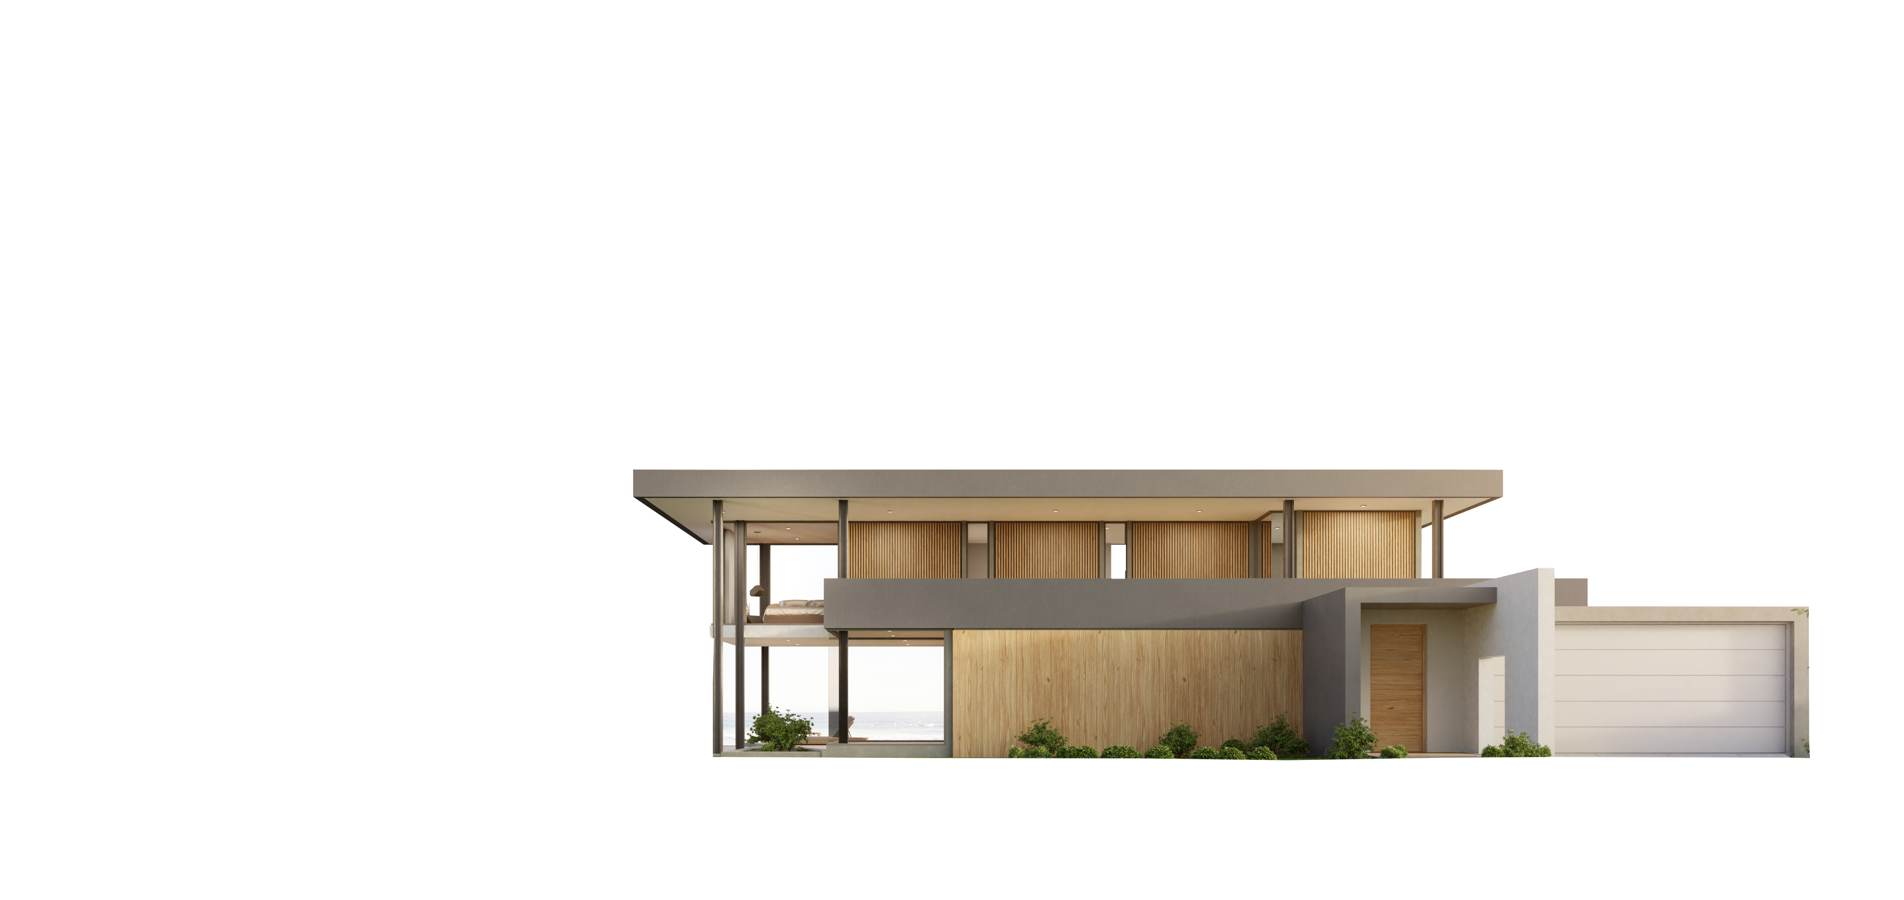


OUR 3 KEY DISRUPTIVE PROPOSITIONS
We are creating a true cradle-to-cradle economy
3.
Our products will not go to (the) waste
Made to last a lifetime, Ö.Wall is an efficient pre-fab, modular system with zero wastage.
You can keep & re-use
or
We can help you recycle
Notes:
whats imp to note here on sustainability -
O.Wall is infinitely re-usable. Never need to throw it.
Net effect is – we future-proof our homes and buildings , and massively reduce demolition, thus reconstruction stemming to co2.
Constructing with O.wall is also more efficient , having next to zero wastage. (this is a huge reduction from traditional built where wastage can be as high as 30%)
its not only o.wall is more waste efficient and reusable , but we are future-proofing buildings therefore reduce demolition ,

Slide 15
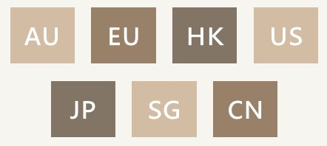
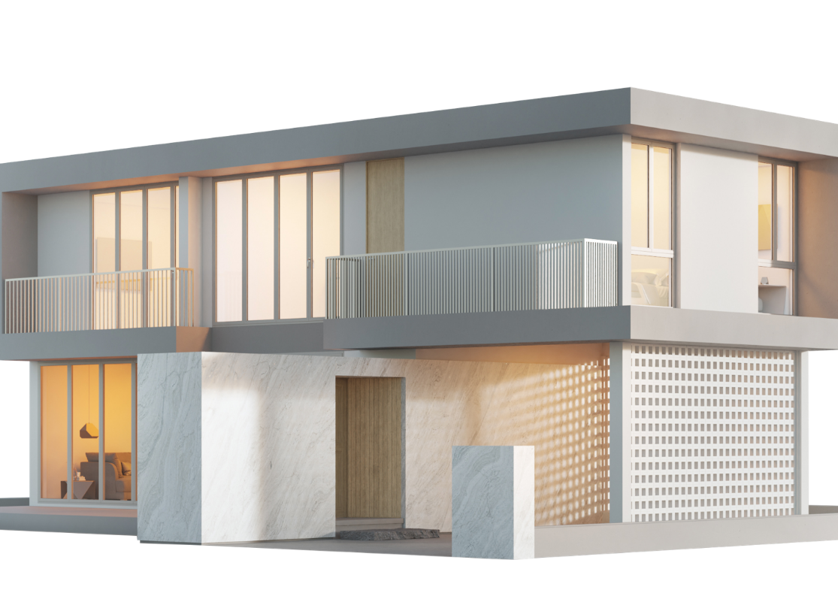
TOTAL ADDRESSABLE MARKET
A building disruption that will capture a gigantic market
Global Construction Market
Building
$4946.1 B
$13,570.90 B
48.1%
$3137.3 B
$171B P/A
$1808.8 B
18M
Total value of residential properties globally addressed by Ö.Wall
Addressable new dwellings yearly in:
REFERENCE: CONSTRUCTION GLOBAL MARKET OPPORTUNITIES AND STRATEGIES TO 2031: COVID-19 IMPACT AND RECOVERY
🇦🇺
🇪🇺
🇭🇰
🇺🇸
Global Market Size for Movable Walls*
🇯🇵
🇸🇬
🇨🇳
2026
USD $1293.3 M
and more
CAGR
2022-2026
9.1%
2022
USD $698.3 M
*GLOBAL MOVABLE WALLS MARKET RESEARCH REPORT 2022
Notes:
When we can touch the chasm in the diffusion of innovation curve, we are looking at 29.1B annual revenue, just for the residiental market, and just for the wall panels.
The residential segment was the largest revenue generator in 2021

Slide 16

TOTAL ADDRESSABLE MARKET
A building disruption that will capture a gigantic market
Global Construction Market Value
Non-
residential
$39.52 T
Non-buildings
$39.35 T
Buildings
$22.87 T
$18.93 T
$171B P/A
$20.42 T
18M
$13.57 T
Addressable new dwellings yearly in:
Total value of residential properties globally addressed by Ö.Wall
Residential
🇦🇺
🇪🇺
🇭🇰
🇺🇸
🇯🇵
🇸🇬
🇨🇳
and more
Global Market Size for Movable Walls*
2026
USD $1293.3 M
REFERENCE: CONSTRUCTION GLOBAL MARKET OPPORTUNITIES AND STRATEGIES TO 2031: COVID-19 IMPACT AND RECOVERY
2022
USD $698.3 M
*GLOBAL MOVABLE WALLS MARKET RESEARCH REPORT 2022
Notes:
When we can touch the chasm in the diffusion of innovation curve, we are looking at 29.1B annual revenue, just for the residiental market, and just for the wall panels.
The residential segment was the largest revenue generator in 2021

Slide 17
TOTAL ADDRESSABLE MARKET
A building disruption that will capture a gigantic market
Global Construction Market Value
Non-
residential
$39.52 T
18M
$171B P/A
Non-buildings
$39.35 T
Buildings
$22.87 T
$18.93 T
$20.42 T
Addressable new dwellings yearly in:
Total value of residential properties globally addressed by Ö.Wall
$13.57 T
Residential
🇦🇺
🇪🇺
🇭🇰
🇺🇸
🇯🇵
🇸🇬
🇨🇳
REFERENCE: CONSTRUCTION GLOBAL MARKET OPPORTUNITIES AND STRATEGIES TO 2031: COVID-19 IMPACT AND RECOVERY
and more
Global Market Size for Movable Walls*
2026
USD $1293.3 M
2022
USD $698.3 M
*GLOBAL MOVABLE WALLS MARKET RESEARCH REPORT 2022
Notes:
When we can touch the chasm in the diffusion of innovation curve, we are looking at 29.1B annual revenue, just for the residiental market, and just for the wall panels.
The residential segment was the largest revenue generator in 2021

Slide 18
TOTAL ADDRESSABLE MARKET
A building disruption that will capture a gigantic market
Non-
residential
Global Construction Market Value
Non-buildings
Buildings
$20.42 T
$39.35 T
$18.93 T
$39.52 T
Residential
$22.87 T
REFERENCE: CONSTRUCTION GLOBAL MARKET OPPORTUNITIES AND STRATEGIES TO 2031: COVID-19 IMPACT AND RECOVERY
$13.57 T
Global Market Size for Movable Walls*
2026
USD $1293.3 M
2022
USD $698.3 M
*GLOBAL MOVABLE WALLS MARKET RESEARCH REPORT 2022
*GLOBAL MOVABLE WALLS MARKET RESEARCH REPORT 2022
Notes:
When we can touch the chasm in the diffusion of innovation curve, we are looking at 29.1B annual revenue, just for the residiental market, and just for the wall panels.
The residential segment was the largest revenue generator in 2021

Slide 19
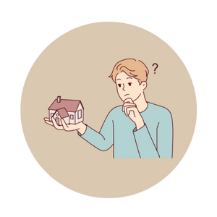





OUR CUSTOMERS
Everyone involved in building homes
Anyone buying or building a new house
Anyone wanting to do a renovation
OUR CUSTOMER PROFILE
Builders who want simplicity and speed
Architects and interior designers
*GLOBAL MOVABLE WALLS MARKET RESEARCH REPORT 2022
Property investors catering to different market demands
Developers aiming for flexibility and cost savings
Notes:
To use an analogy, it Is creating 100’s of new carbon capture tech or renwable energy sources, but still using incandescent light bulb.

Slide 20








MASSIVE ADDRESSABLE MARKET OPPORTUNITY
More than just for homes
Offices
Hospitality spaces
Exhibition spaces
Museums
Retail
Schools
Conference Centers
Clinics
Notes:
To use an analogy, it Is creating 100’s of new carbon capture tech or renwable energy sources, but still using incandescent light bulb.

Slide 21
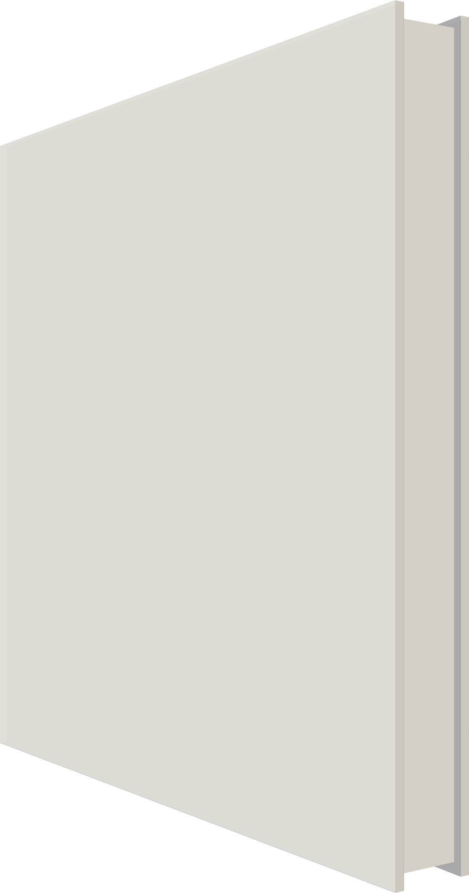





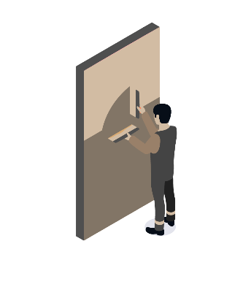
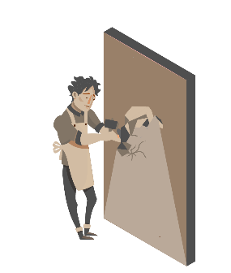
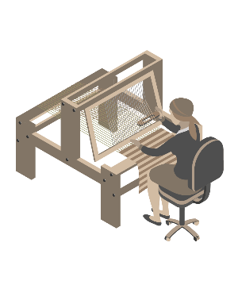


Cornices
BUSINESS MODEL
Ö.Ecosystem – The everything app for all your design & building needs
Phase-2 Production
(Ö.ARCHITECTURE)
PHASE-1 PRODUCTION
(Ö.INTERIORS)
APPS
Parametric
AI App
AR / VR
Vizualisation
Software Plug-ins
WEBSITE & RETAIL
ASSEMBLY
SERVICE
External Walls
Ö.Walls
Doors
Subscription Revenue Stream
Floorings
Consumers
Lights
Ceilings
Sockets
Builders
Roof
Glass Walls
Products
SPACE
Sales Revenue Stream
Developers
Service
Revenue
Stream
HOME
Windows
Skins
Architects/
Int. Designers
Trims
Royalty Stream
Bath Pods
Connectors
Corporate
NEW ECONONOMY OF CREATORS & PRODUCTS
COMMERCIAL
AR-Interior Designers
Artists
Sculptors
Material Arts
‘IOT-For-Homes’
Brands
Interior designs that augments the virtual to physical
Art that is beyond the canvas
Art that transcends the surface
New materiality and textures in interiors
A new wave of industrial designers
for smart homes
Luxe-Coin designer home Interiors
Notes:
my fav slide. grand vision at a glance
and bottom is the most exciting part
products -
software - pro vs free
giving tools to creators - kinda what apple did with app store.
we will see a new wave of designs in our PHYSICAL WORLD
Lament about meta - verse - lets talk virtual homes $5m - lux coin - gucci

Slide 22





COMPETITION
Expanding on an indisputable competitive moat
Traditional Housing
“Movable” Walls
Ö.Wall
All the added features plus a massive cost-saving benefits
Living space mobility
Our walls and homes are static up until demolition
Only retractable within a single axis
Infinitely dynamic Ö.Walls can be moved to any desired positions
USD $510
Up To 35%
CHEAPER
USD $430
Materials reusability
Our homes have, are, and will be producing even more waste
Retractable walls can only be on special hinges that are costly to install
Reassemble and customise Ö.Walls as much as you desire
USD $330
Partition Brick Wall
Stud wall
Assembly complexity
“Assembling” a home is as hard as it gets
Require significant planning and specialist before installation
No special tools or specialists required. Assemble Ö.Walls just like Lego!
GENERIC PARTITION WALLS*
Ö.WALL*
*Per module @3ft wide x 8ft high in the U.S.A market
Notes:
I can safely say there is truly no direct competition, we can look at the indirect competition –
Movable – limited movement, need special hinges , complex to plan and install
O – it goes anywhere and reusable
and we will launch it lower than a traifiton walll

Slide 23


FINANCIAL MODEL
Strong unit economics and scaling profitability as we grow
Ö.Wall. EBITDA, USD per metre, Year 1
Ö.Wall. EBITDA, USD per metre, Year 5
420
330
80
140
180
200
120
20
Revenue
COGS
Operating expenses
EBITDA
Revenue
COGS
Operating expenses
EBITDA
Notes:
pilot year - high COGS , breakeven at best
but when we scale = cogs fraction.
automate processess, own prodiuctoipn facilities ,

Slide 24



OUR TEAM
1
Aaron Teo
Fabien Gaussorgues
Naresh
FOUNDER / THE SPACEMAN
CTO / THE ATOM MAN
CODE DEVELOPER / ONES & ZEROS
Multi-disciplinary architect with over 17 years of experience in pre-fab, residential, product design,
a serial entrepreneur, and inventor
Engineer with 25 years experience in the field of product development, manufacturing and logistics
Programmer s
Notes:
My background in architecture since 2005, headspace in residential and modular design. designed pre-fab container housing and kit of part homes. I founded oopenspace in 2015 as a furniture + design, having been exposed to retail sector , logistics manufacturing .imp - Exposed me to the consumer psychology, the micro-details of everyday uses and interaction.
I have known and worked with Peter and Fabien for years. Fabien has a great exp in the production, procurement and engineer aspect. Being in HK for over 20 years. He will be the man to ensure the production and product quality at highest level.
Peter runs a multi-mill retail biz in SG, distributor for king koil mattresses and Ashely furniture . He will get us to scale when we expand inSG

Slide 25




TRACTION
We have secured MOUs for 4 projects
Student Housing
Mix-Use Apartment
Townhouses
Single-storey homes
Notes:
my fav slide. grand vision at a glance
and bottom is the most exciting part
products -
software - pro vs free
giving tools to creators - kinda what apple did with app store.
we will see a new wave of designs in our PHYSICAL WORLD
Lament about meta - verse - lets talk virtual homes $5m - lux coin - gucci

Slide 26

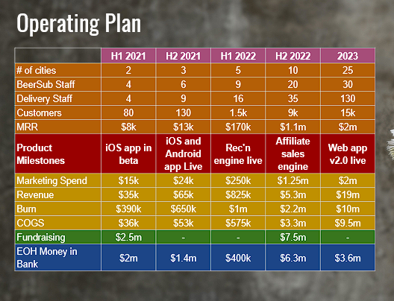
GTM
Go-To-Market Plan & Revenue Forecast
1
2021-2022
Ö.Wall Revenue Forecast*
R&D AND MARKET SURVEY
2B
MOU for 4 development projects
Prototype
Patent submission
B2C/B2B sales network established
Logistics & warehousing established
Brand recognition
1.5B
Series-A Raise
Seed Raise
1B
Pre Seed Raise
0.5B
0
Year 1
Year 2
Year 3
Year 4
Year 5
Year 6
*Does not include accessories or other revenue streams
2
2022-2023
3
2023-2024
PRODUCT COMMERCIALISATION
PILOT YEAR & PRODUCT MARKET FIT
Pre-seed raise of USD$1.1M
Commercialized product line
Media & public outreach
Online shop & Interior design app
Launch of Ö.Wall
Seed raise of USD$13M
Assembly Facility
Flagship display house
Marketing & mass media campaigns
Parametric & AI development
App market ‘space’
Brand partnership & collaboration
Missing financial plan breakdown per year, target staff headcount, and other metrics. See reference below
Notes:
My background in architecture since 2005, headspace in residential and modular design. designed pre-fab container housing and kit of part homes. I founded oopenspace in 2015 as a furniture + design, having been exposed to retail sector , logistics manufacturing .imp - Exposed me to the consumer psychology, the micro-details of everyday uses and interaction.
I have known and worked with Peter and Fabien for years. Fabien has a great exp in the production, procurement and engineer aspect. Being in HK for over 20 years. He will be the man to ensure the production and product quality at highest level.
Peter runs a multi-mill retail biz in SG, distributor for king koil mattresses and Ashely furniture . He will get us to scale when we expand inSG

Slide 27
OUR ASK AND USE OF FUNDS
Raising USD$1.1M in pre-seed funding
2
2022-2023
RND
PRODUCT COMMERCIALISATION
$490K
Pre-seed raise of USD$1.1M
Commercialized product line
Media & public outreach
Online shop & Interior design app
Launch of Ö.Wall
COGS
$170K
CAPEX
MARKETING & APP
$330K
$110K
Notes:
My background in architecture since 2005, headspace in residential and modular design. designed pre-fab container housing and kit of part homes. I founded oopenspace in 2015 as a furniture + design, having been exposed to retail sector , logistics manufacturing .imp - Exposed me to the consumer psychology, the micro-details of everyday uses and interaction.
I have known and worked with Peter and Fabien for years. Fabien has a great exp in the production, procurement and engineer aspect. Being in HK for over 20 years. He will be the man to ensure the production and product quality at highest level.
Peter runs a multi-mill retail biz in SG, distributor for king koil mattresses and Ashely furniture . He will get us to scale when we expand inSG

Slide 28

WHY NOW
We are way overdue for change in the way we build & live
Cease the wanton demolition & inefficient ways in which we build and inhabit our homes
An increasing need to embrace a circular economy to reach net zero by 2050
Join us to pioneer this once-in-a-generation movement that will revolutionize how we decide to inhabit our homes- to be affordable, adaptable, and infinitely sustainable.
Global trend of multi-generational living is rapidly growing
The world is more creative, and we have the tools & building blocks to put into the hands of everyone to enhance our built-environment
Notes:
Re-create your home to fit you each time your lifestyle changes.
Do it sustainably with zero waste and environmentally friendly materials.
Completed within a day with minimal costs.

Slide 29
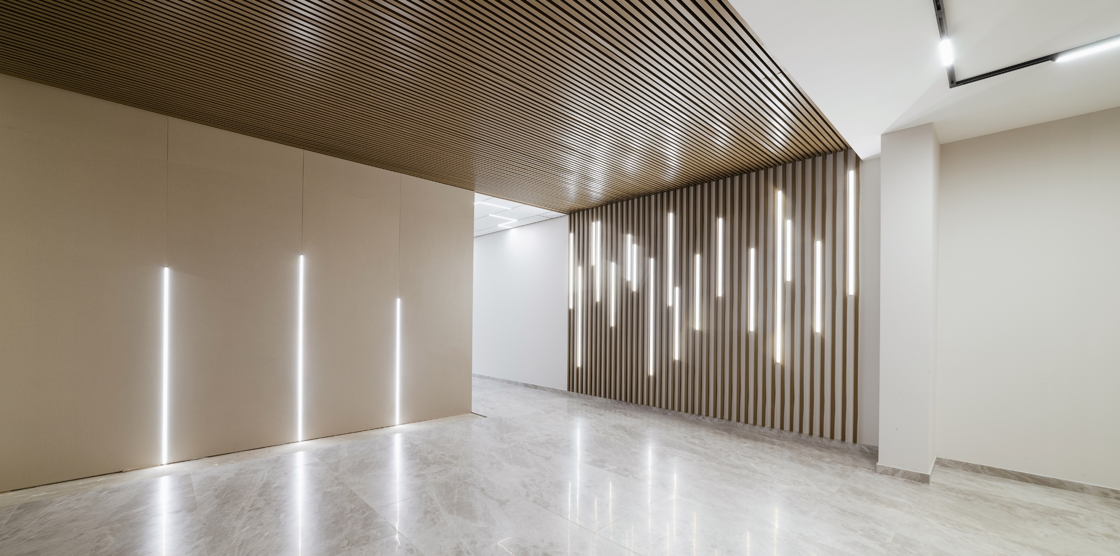



Q
& A
Info
Aaron Teo, Founder
aaron@oopenspace.com
(+61) 47250 2198
Notes:
WHY NOW?
How we live and build is way overdue for change.
we are at a pivotal moment to revrse our carbon footprint- We need to battle CO2 from both ends - new tech, and re-examining at e status quo. To use an analogy, we can have the most advanc new carbon capture tech or renwable energy sources, but still using incandescent light bulb.
With the threat of climate change and buildings being one of the most significant contributors to CO2 emissions, our world needs more affordable, adaptable, and sustainable housing.
We cannot continue with the rampant demolition. We need to construct more efficiently by future-proofing our homes & buildings to be more affordable, improving our quality of life by enhancing the quality and use of our spaces.

Slide 30

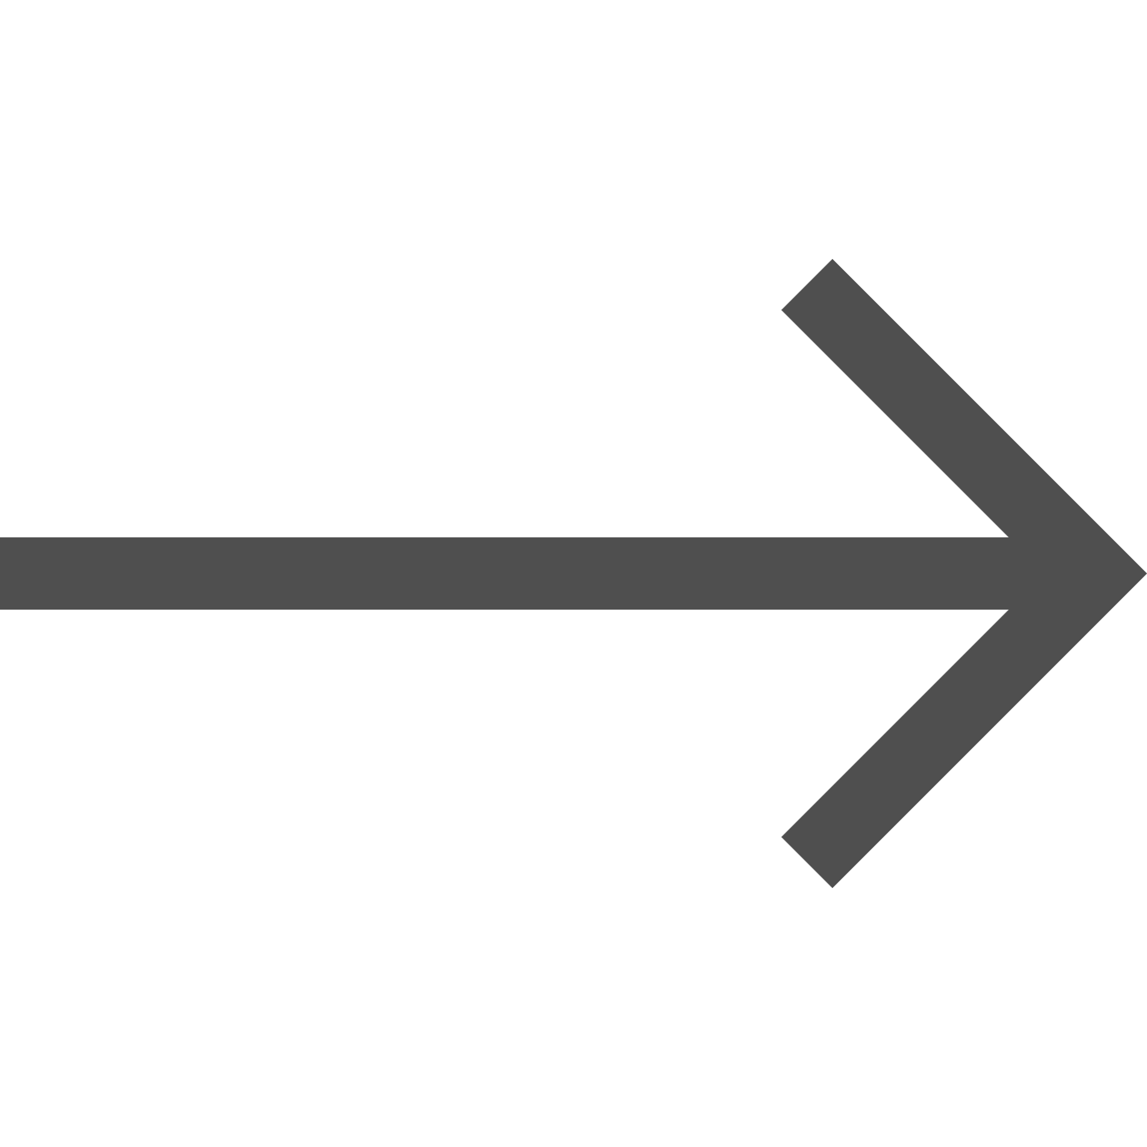
Additional
Appendix slides

Slide 31
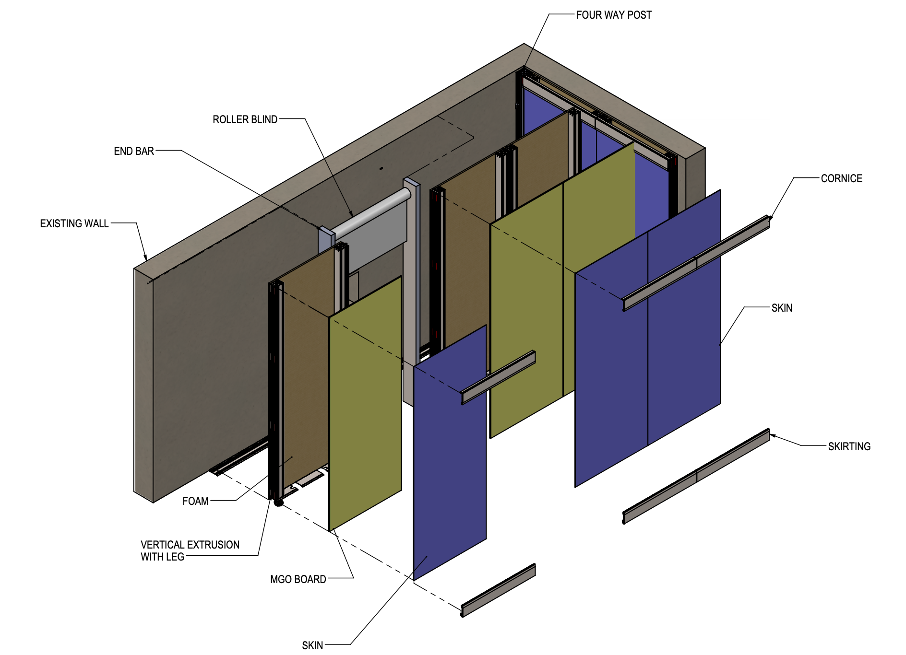
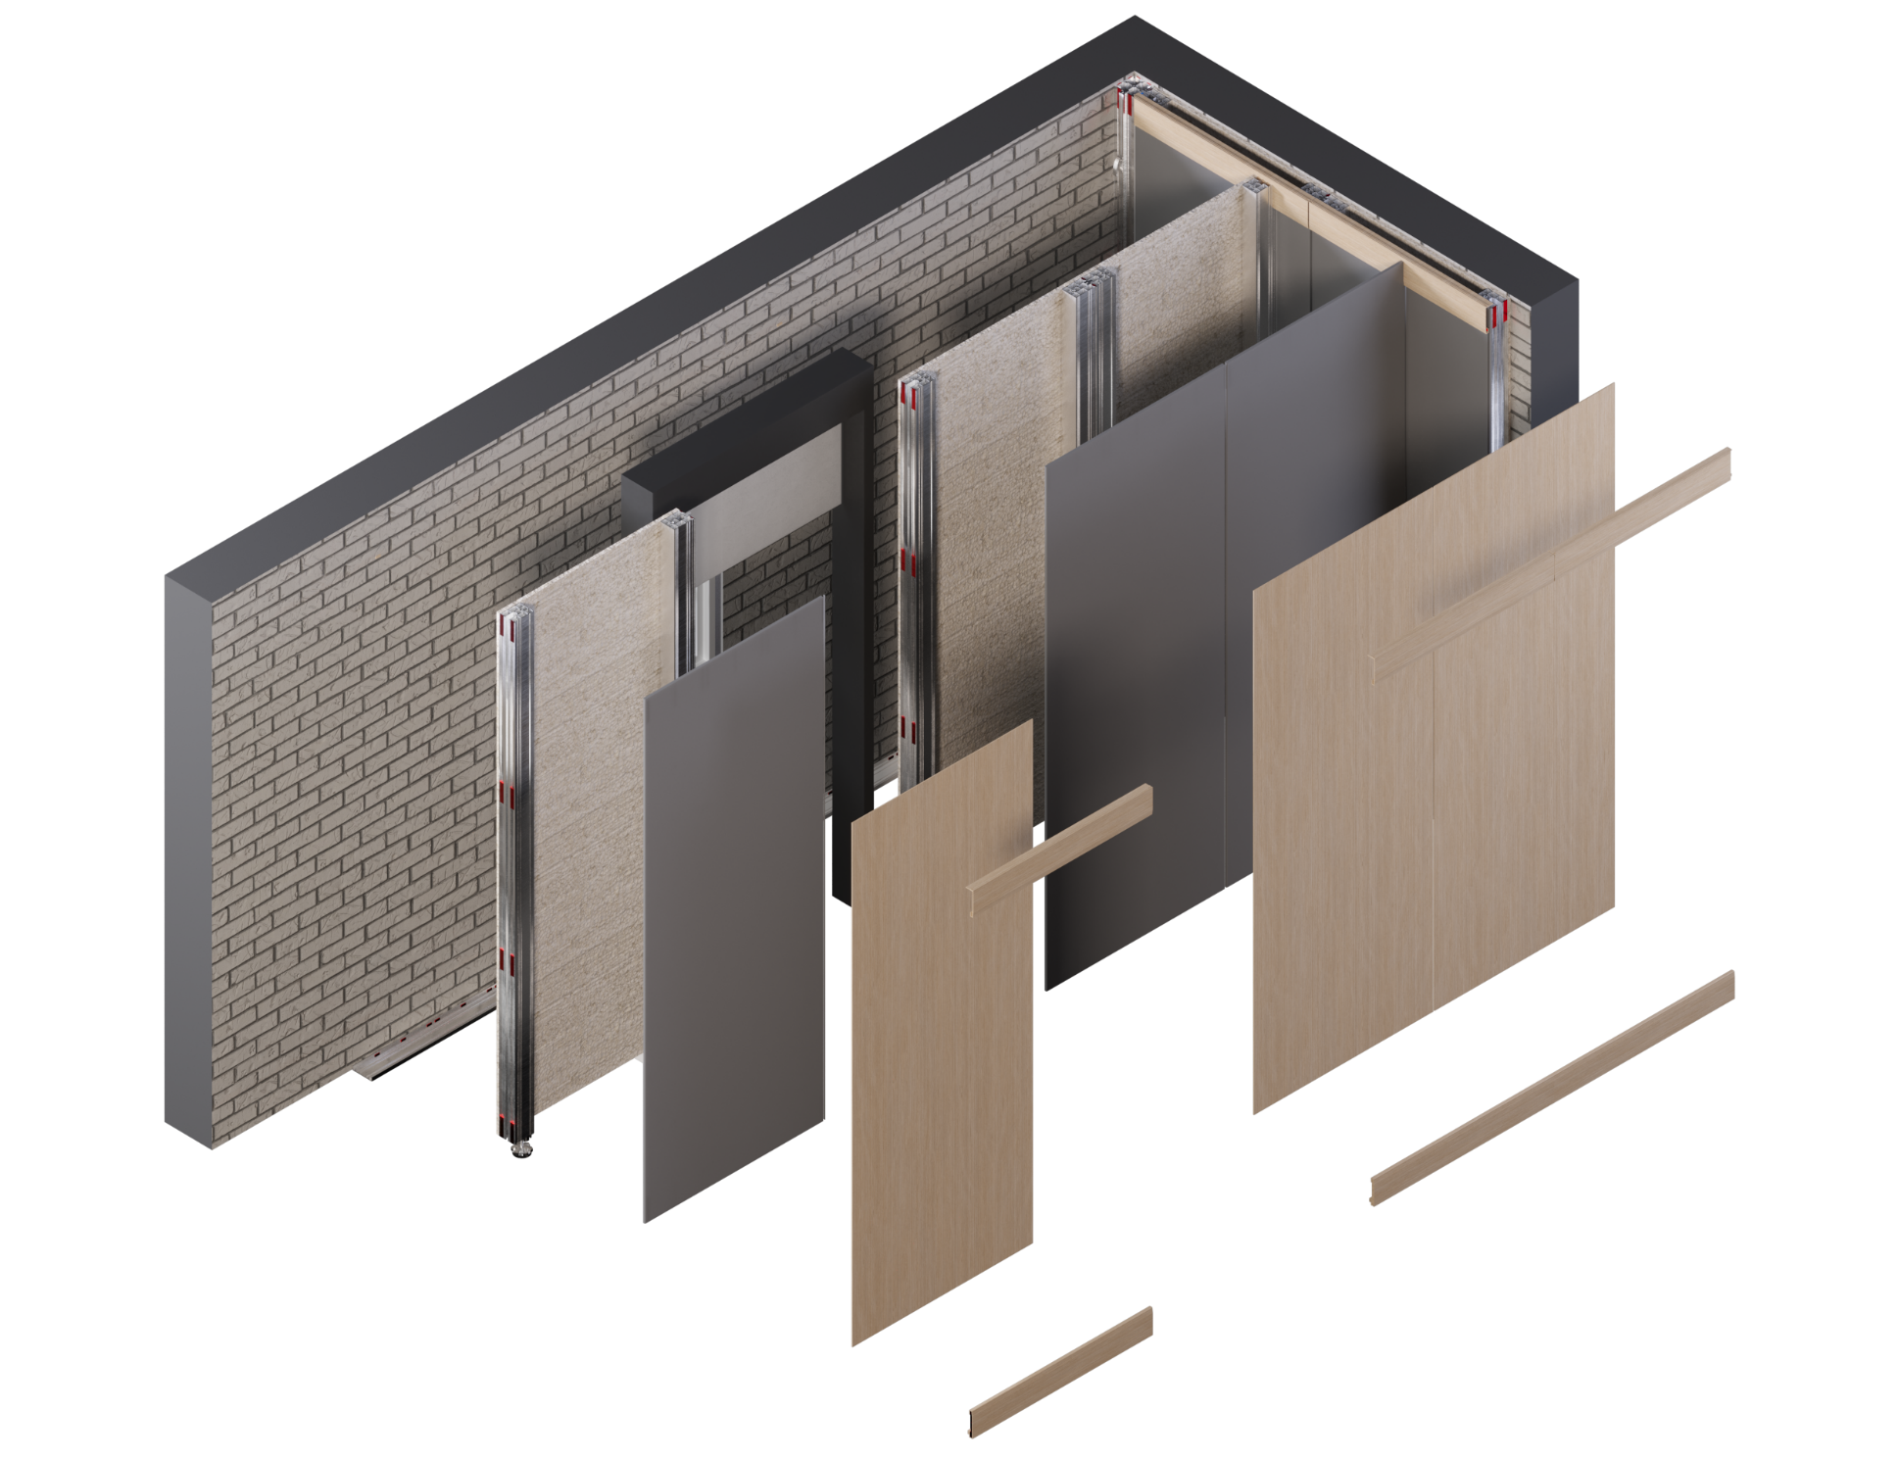
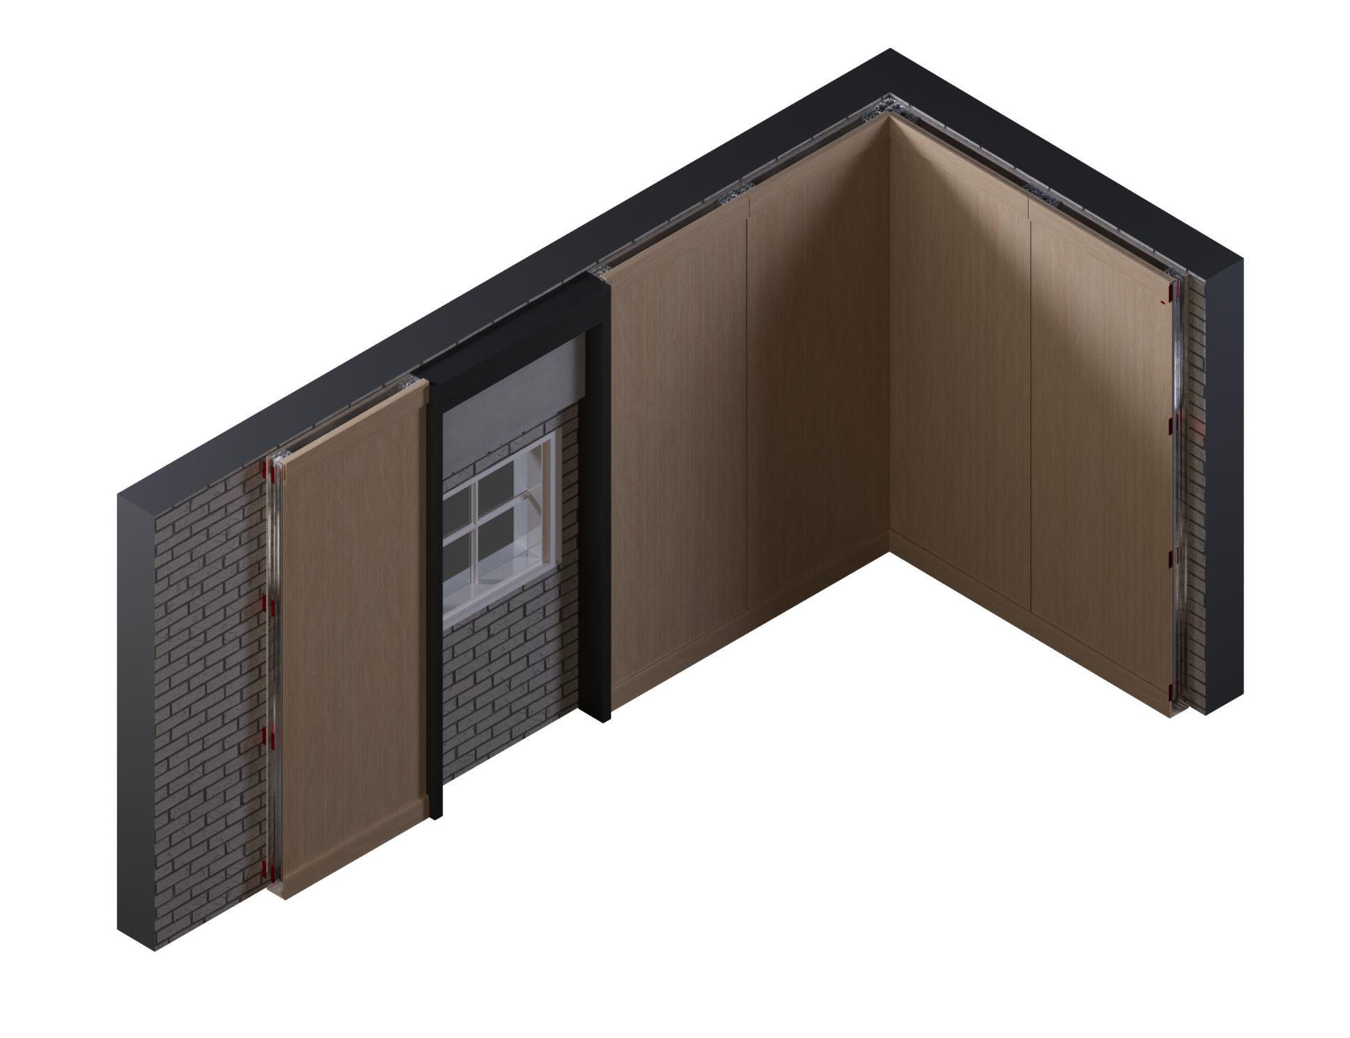
OUR PRODUCT
RetrÖ.Fit
Make an existing space more sustainable
Lay over existing walls to have complete Öopenspace integration while providing superior thermal insulation and acoustic privacy
Easy to assemble

Slide 32
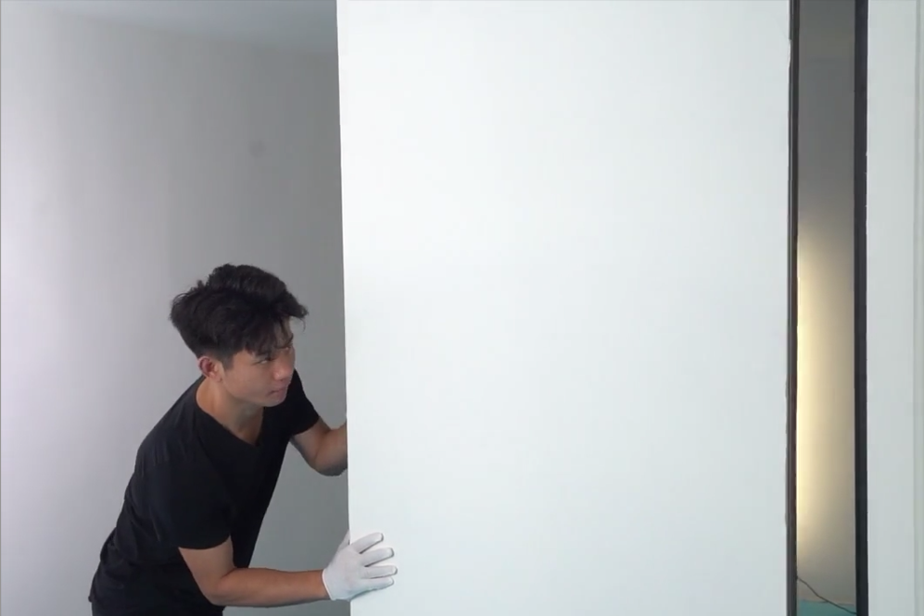
Ö.WALL PROTOTYPE VIDEO
The world’s first, truly moveable wall system
Overview
No need for drilling into floor
No need for drilling into ceiling
No professional tools needed
No painting or plastering
No specialists or contractors
Two persons can install it
Notes:
60 secs
special = small us

Slide 33
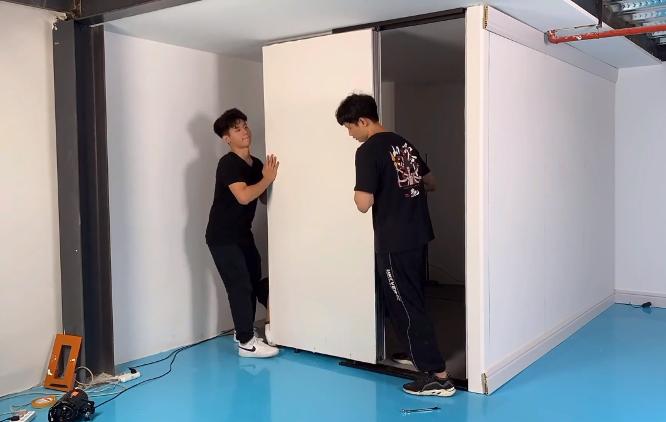
Ö.WALL TIMELAPSE
The world’s first, truly moveable wall system
Overview
No need for drilling into floor
No need for drilling into ceiling
No professional tools needed
No painting or plastering
No specialists or contractors
Two persons can install it
Notes:
60 secs
special = small us

Slide 34
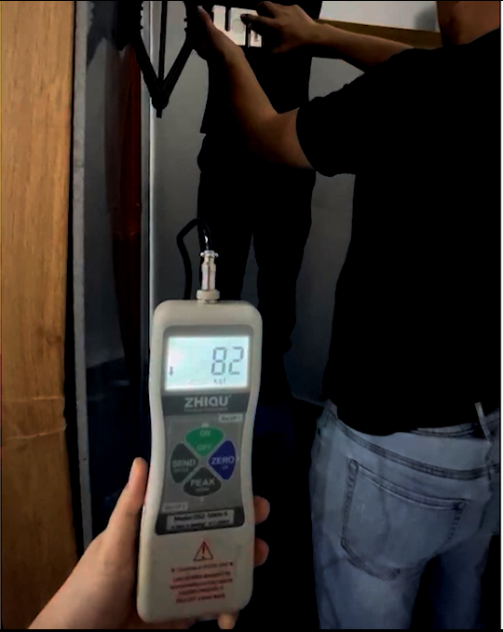
Beyond the standard stress-loading requirements
BCA Requirements –
Stiffness:
Partition Wall is subjected to a horizontal force of 500 N (50kg) applied at a height of 1.5 m. Maximum deflection and residual deformation should be within specified limits. Test simulates bending caused by people leaning on, or person on ladder leaning against the partition wall.
Large Soft Body Impact:
Partition Wall is subjected to a 50 kg load in the form of a sphero-conical bag swung against the wall. Permanent deformation should not exceed 2 mm, with no structural damage.
The video shows that Ö.Wall surpasses the required stress loadings, and only dislodges at 800N.
Notes:
u are asking - can a wall hold up without drilling and securing into floors / ceoiling?
we tested it.
remove because un-safe
or speed it up
Wall non cap

